Slide 1
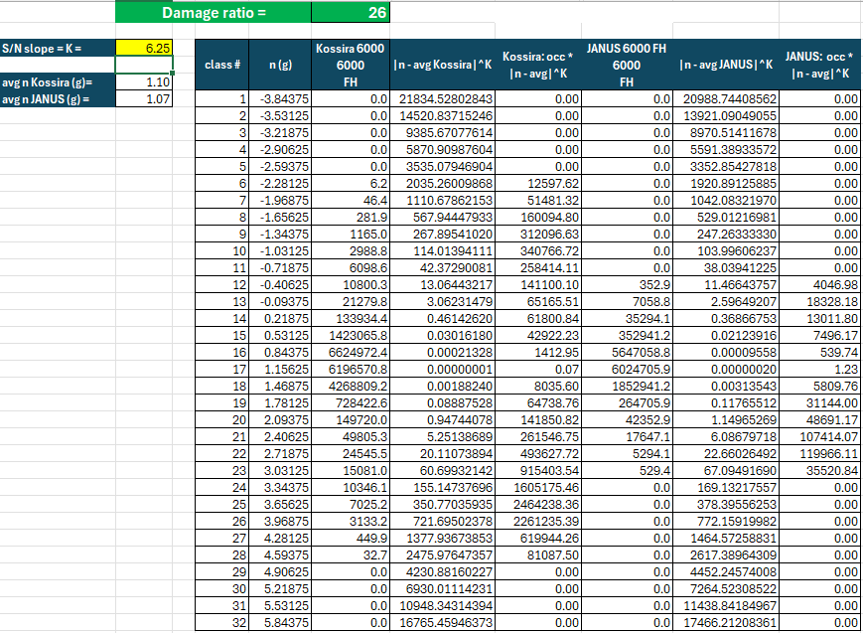
Kossira occurrences normalized @ 6000FH
Janus occurrences normalized @ 6000FH
Weighting factor centered on Kossira average g due to S/N curve
Weighting factor centered on Janus average g due to S/N curve

